Slide 1

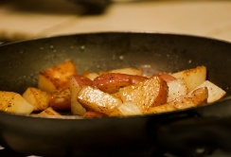






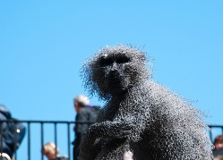
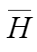
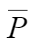
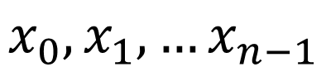
Score Pivots
P
$$x_{0},x_{1},…x_{n−1}$$
Encoder
Layer Norm
P
H
Adaptive Ranking Transformer
(ART)
Multi-Head Attention
Q
K
V
Adaptive Ranking Transformer
(ART)
0 %
100 %
Adaptive Ranking Transformer
(ART)
Score
Score pivot
Feature vector

Slide 2



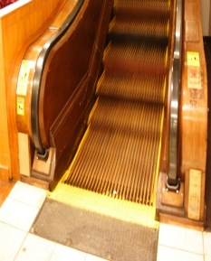








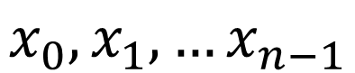
Adaptive Ranking Transformers (ART)
Updating
Mechanism
Feature Extraction
Input Images
Self-Attention
ResNet50
Feature Self-Update
$$x_{0},x_{1},…x_{n−1}$$
CNN
Feature-Pivot Cross-Update
CNN
Cross-Attention
Attention Module
Pivot Self-Update
CNN
L_{MAE}
L_{center}
L_{metric}
L_{order}
L_{total}
Loss Functions
Concatenated
Feature Map
Output

Slide 3
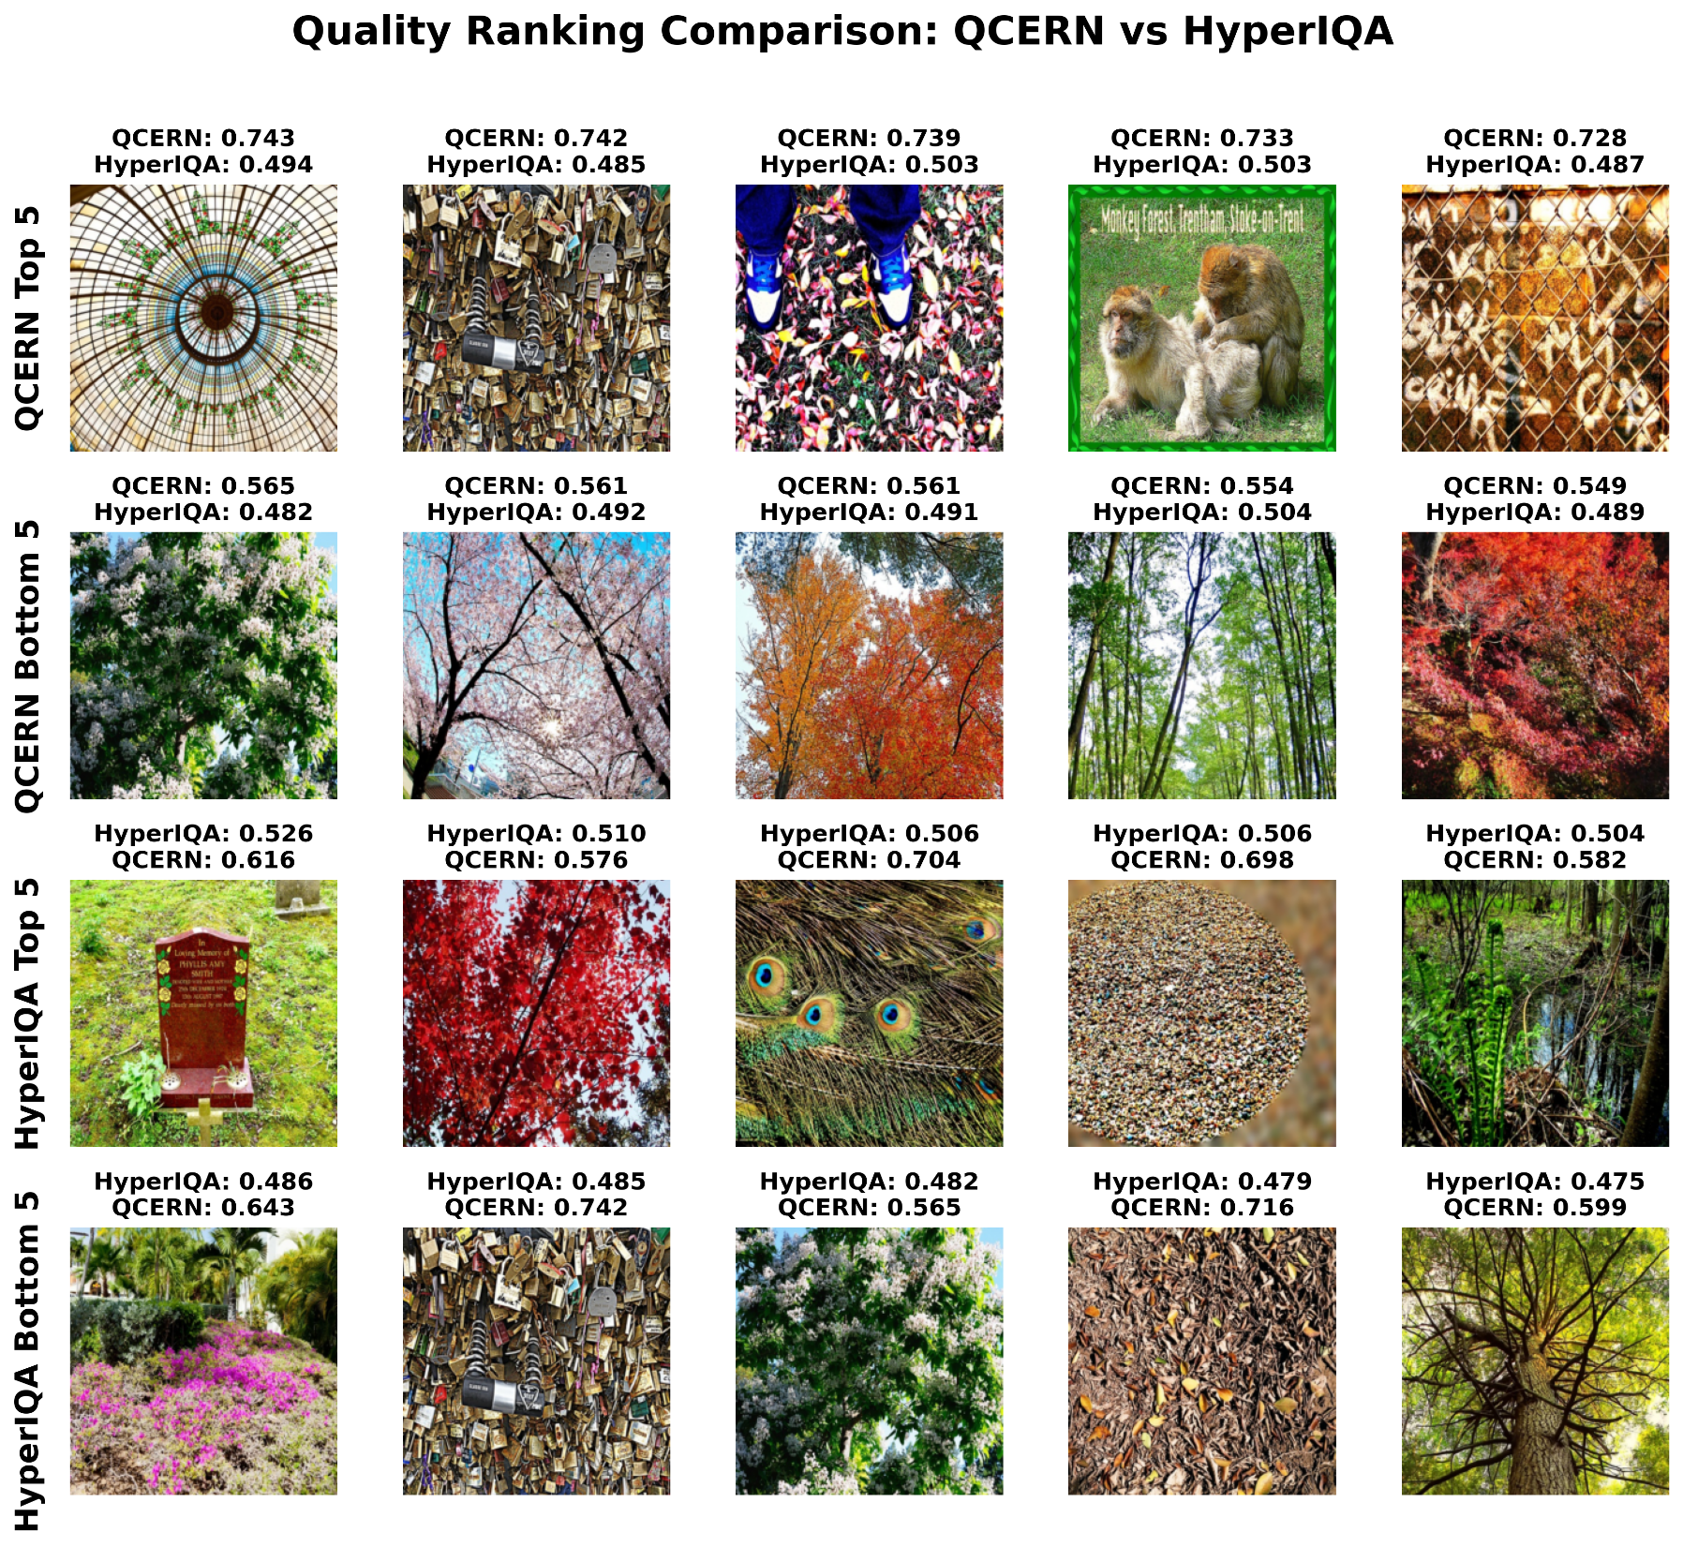

Slide 4
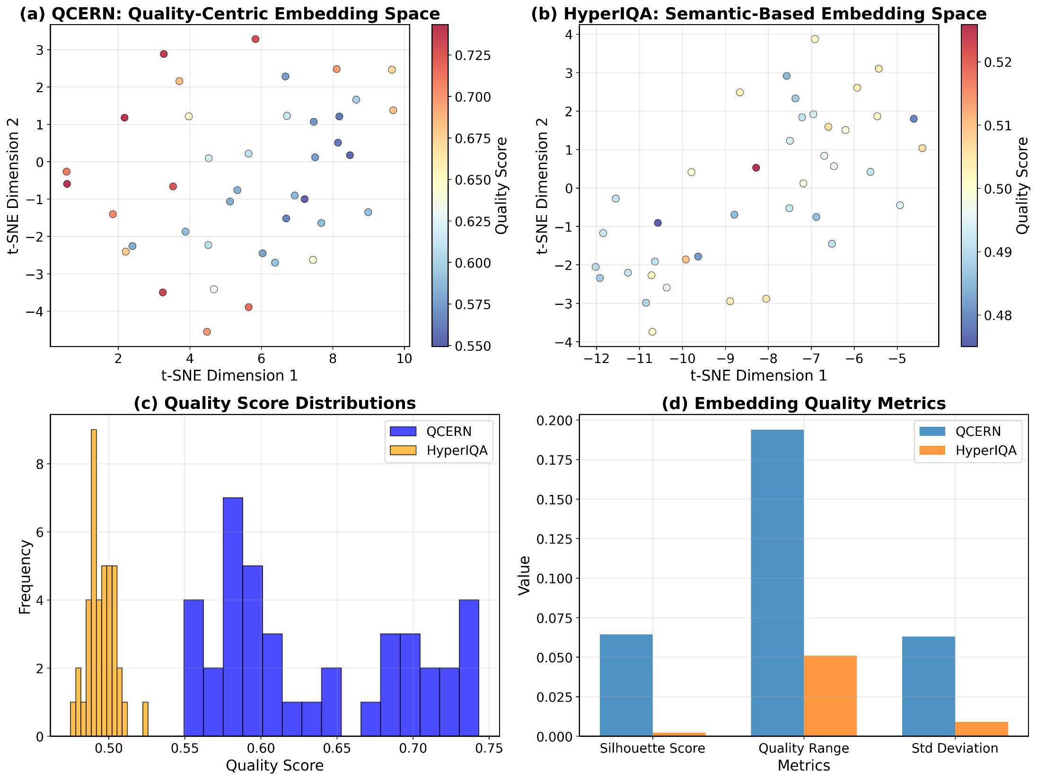

Slide 5
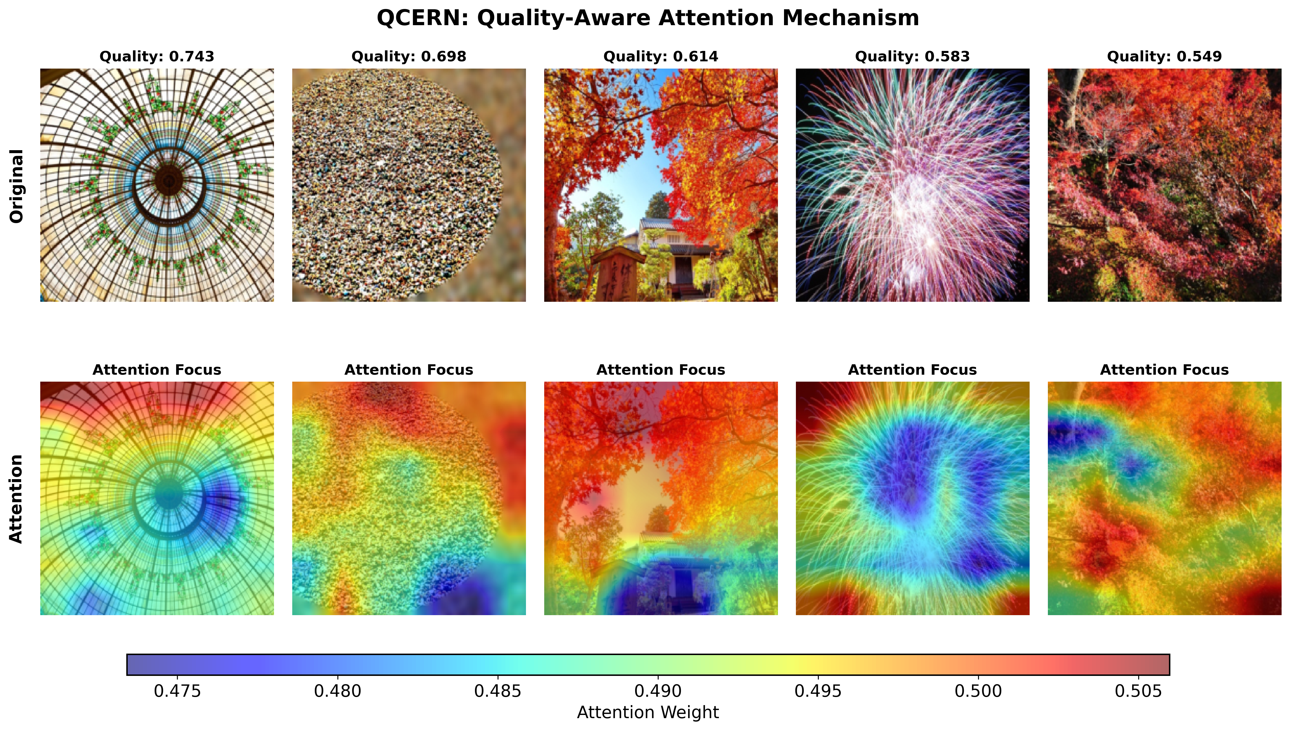

Slide 6
